Slide 1

Design And Development Of Corporate Website
Review 1
Work done by
Under The Guidance of
ROHITH S
Msc.,Mphil.,ph.D
DR. N. MAHENDIRAN
23106108
3rd BSC CS SHIFT-2

Slide 2

INTRODUCTION
This project focuses on the design and development of a corporate website for Vijay Industries, a company engaged in the reselling of electrical transformers. The main goal of this project is to provide the company with a strong digital presence and to simplify the way customers interact with the business. In the traditional system, customers faced difficulties in accessing product information and sending inquiries, which caused delays in communication and sales processes.
The website is designed to offer an interactive and user-friendly platform where customers can easily browse transformer products, view detailed specifications, compare different models, and request quotations online.
2

Slide 3
Abstract
This project presents the design and development of a dynamic web platform for Vijay Industries, a company specializing in the reselling of electrical transformers. The website aims to streamline product visibility, customer engagement, and sales operations by providing an intuitive and user-friendly interface. Key features include a comprehensive product catalog, detailed transformer specifications, inquiry and quotation modules, and an efficient content management system for easy updates. The platform enhances the company’s digital presence, allowing customers to conveniently browse available transformer models, compare specifications, and request quotations online. By integrating modern web technologies and responsive design principles, the website ensures accessibility across devices and improves overall customer experience. This project ultimately supports Vijay Industries in expanding its market reach, optimizing communication, and strengthening its position within the transformer reselling sector..
2

Slide 4
Existing system
The clients can’t reach easily and the response time is delaying
The company has to show the catalogue to everyone personally it’s a time delaying process
The quotation models are not efficient to send.

Slide 5

Proposed solution
The website aims to streamline product visibility, customer engagement, and sales operations by providing an intuitive and user-friendly interface.
Key features include a comprehensive product catalog, detailed transformer specifications, inquiry and quotation modules, and an efficient content management system for easy updates.
And conveniently browse available transformer models, compare specifications, and request quotations online.

Slide 6
Hardware Requirements
Processor :Intel i5-1335U 13th Gen(R) Core(TM)
RAM : 16.0 GB (DDR5)
Storage : 512 GB (ssd)
System : Windows 11 OS
5

Slide 7
Software Requirements
Platforms used : Visual studio code,Github,Vercel
Languages used : Html,CSS,Java script
Database : Firebase
Backend : python(flask)

Slide 8
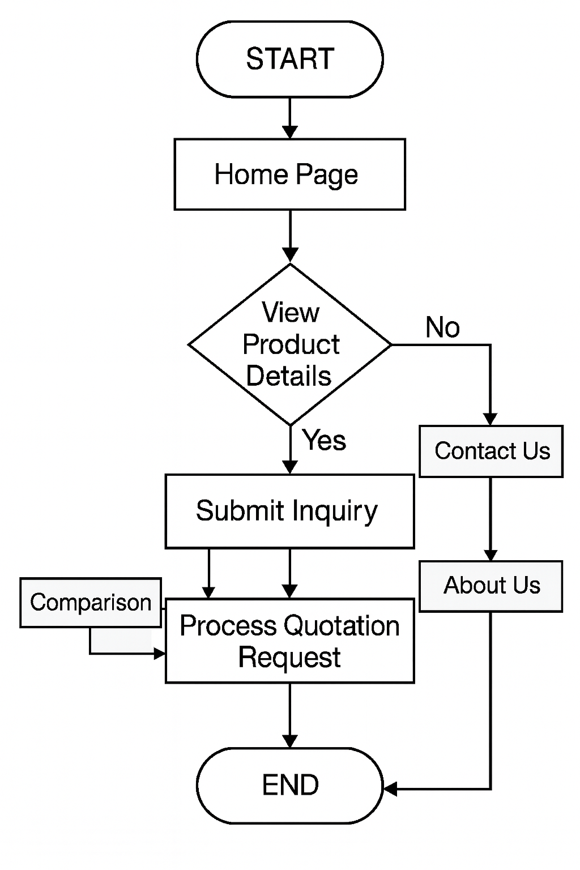
Data Flow Diagram

Slide 9
THANK YOU !

